Slide 1

Final Project
Car Rental Service
C-450
Joshua Willis

Slide 2

Slides Roadmap
System Description
System Features
Database Backend
Admin Login Demo
Admin GUI Demo
User Flow Demo

Slide 3
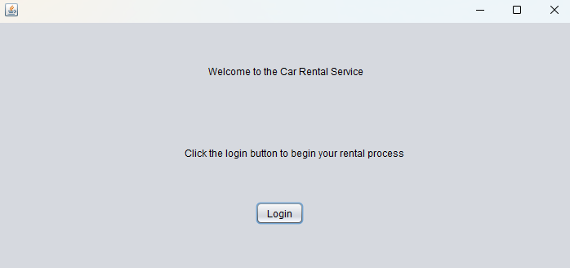
Car Rental Program
A product for users looking to rent a vehicle that allows them to browse available cars and choose one to rent. The system shows the users the daily cost of each vehicle and totals their cost at checkout depending on which vehicle and how many days they choose to rent for.

Slide 4
Program Features

Slide 5
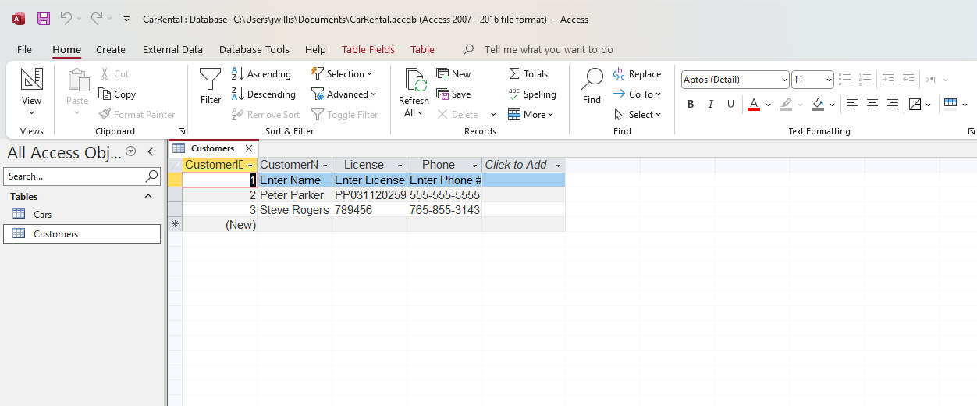
Database backend
Program data is stored in a Microsoft Access database

Slide 6

Admin Demo Presentation

Slide 7
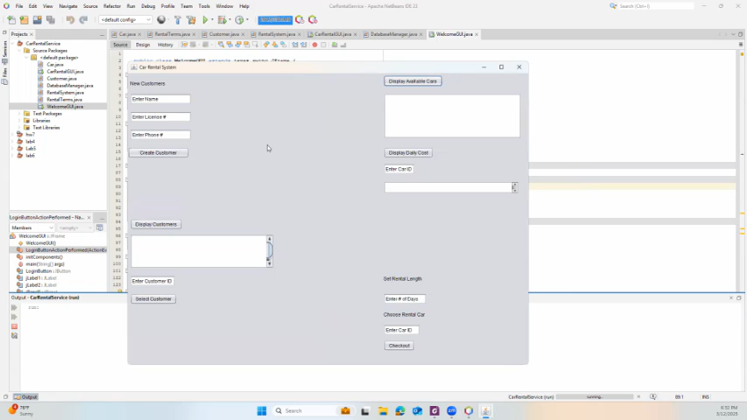
User Flow Demo Presentation

